Slide 1
What to Expect from the DRA-2
Benefits
Training
Timeline
Caryn Camp
Morrison Academy
April PL 2011

Slide 2
Have you ever asked yourself…

Slide 3
Why is half my class not paying attention?

Slide 4
I’m told to
“differentiate the curriculum”
… but how am I supposed to do that?
OR
Does differentiation really work?

Slide 5
I have some students who can’t read at grade-level, but they don’t qualify for any extra help from ELL or Special Needs. What am I supposed to do?

Slide 6
If everyone else can read the text, why can’t those few students? Is it because they weren’t paying attention last year? Not trying hard enough?

Slide 7
Is it a reflection on me, as a teacher, if a student doesn’t read at grade-level by the end of the year? Did I not do a good enough job?

Slide 8
And the answer is…

Slide 9
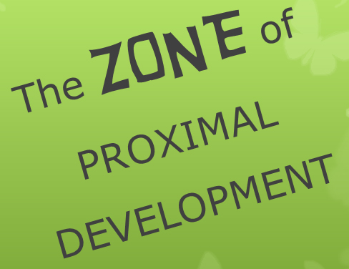

Slide 10
At this time…
Be relaxed by the soft green color and the butterflies!

Slide 11
What is The Zone?
Think of Goldilocks and the Three Bears. Goldilocks didn’t choose the porridge that was too hot or too cold, the chair that was too tall or too wide, the bed that was too hard or too soft. She chose the ones that were “just right.”
Now think of Goldilocks and the Three Books. One is too hard, one is too easy, and one is “just right” as long as she has a little help.
If she is reading the one that is “just right” as long as she has a little help, she is in her ZONE OF PROXIMAL DEVELOPMENT.

Slide 12
The Zone = Instructional Level
Too hard | “Just right” | Too easy
Frustration Level | Instructional Level | Independent Level
≤ 89% | 90 – 94% | ≥95%
The Zone of Proximal Development, for Reading Instruction, is the student’s “instructional level.” This is when the student can read 90 – 94% of the words in the text with comprehension.
NOTE: It is possible that a student may be able to read 90 – 94% of the words in the text without having adequate comprehension of the text. If that is the case, the instructional level would be decreased to a simpler level of text. Even though the student would then be able to read over 95% of the words in the text, there has to be comprehension of what one is reading. For that student, the instructional focus would be on improving comprehension strategies.

Slide 13
95-100% | Independent Level | The reading level of the text is easy enough for the student to read that he/she can read it independently. | Reading this level will not result in student increasing his/her reading level. Reading this level will increase the student’s level of confidence and enjoyment with reading. (“Learning” will be related to the content and comprehension of the content, but not related to increasing one’s reading level.)
90-94% | Instructional level | The reading level of the text is challenging, but success is achievable with guidance. This is the level that would be used during Guided Reading groups. | Zone of Proximal Development: This is where learning will occur with appropriate scaffolding.
89% or less | Frustration Level | The reading level of the text is too difficult, and will most likely result in the student feeling frustrated and discouraged about his/her reading ability. | Reading this level will not result in student increasing his/her reading level.

Slide 14
What Differentiation won’t do…

Slide 15
No matter how much differentiation is provided by the teacher, the reading level of the text is not going to change. For some students, that reading level will be at their “frustration level.” For other students, that reading level will be at their “independent level.” For the students in these two categories, this text will not help improve their reading level.
This is the problem with using one text for the whole class.

Slide 16
What Differentiation will do…

Slide 17
Differentiation will allow all students to learn something about the topic, or about comprehension strategies, or about language skills such as the use of metaphors and similes.
For some students, this will require the text be read out loud to them so that they may use their “listening comprehension.”
For many students with learning disabilities, their reading level would be quite high if it were based solely on their ability to comprehend, and not on their ability to decode.

Slide 18
Here’s the problem:
If the goal is to improve a student’s reading level, then the text must be at his/her “instructional level,” and that will not be the same for everyone in the class.

Slide 19
Here’s (part of) the solution:
Assess the student’s reading level (2011-2012)
Utilize leveled books
Move toward small group instruction based, in part, on the “instructional level” of the students. (Guided Reading groups) (2012-2013)
Monitor the growth of each student’s reading level

Slide 20
Goal for 2011-2012:
Step 1: Assess the Student’s Reading Level
DRA-2 = Developmental Reading Assessment
The DRA-2 will be used to assess each student’s reading level beginning in 2011-2012.

Slide 21

The Sales Pitch…
Source: Pearson Education Inc. “DRA-2 Training DVD for grades 4-8”

Slide 22

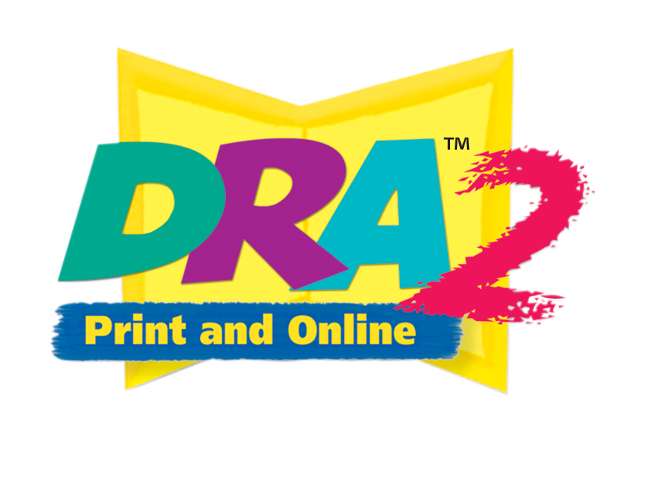



Assessment That Drives Success!
Developmental Reading Assessment®
Second Edition
DRA2 Handheld–Tango™
Software Edition

Slide 23

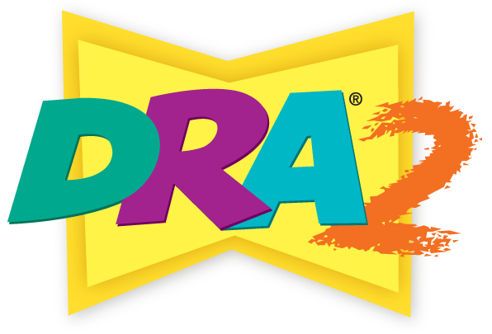
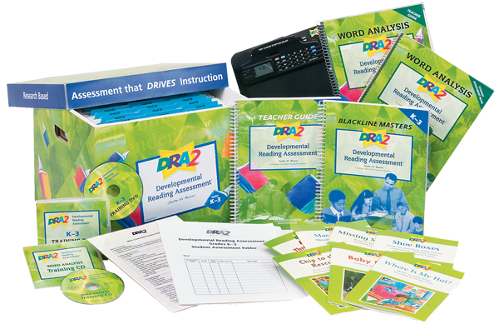
Components
DRA2 K-3, DRA2 4-8 & EDL2 K-6 Comprehensive Kits
Teacher Guide
Benchmark Assessment Books
Blackline Masters Book and CD
Student Assessment Folders
Organizer with Hanging Folders
Training DVD
DRA2 Word Analysis (Grades K–3 Kit only)
  Teacher Guide
  Student Assessment Book
  Training DVD
Professional development on demand
DRA2 Clipboard
Assessment Procedures Overview Card
K-3 Comprehensive Kit
OPTIONAL:
DRA2 Online Management System
DRA2 Online Writer (Digital Pen)
DRA2 Handheld Tango Software Edition

Slide 24
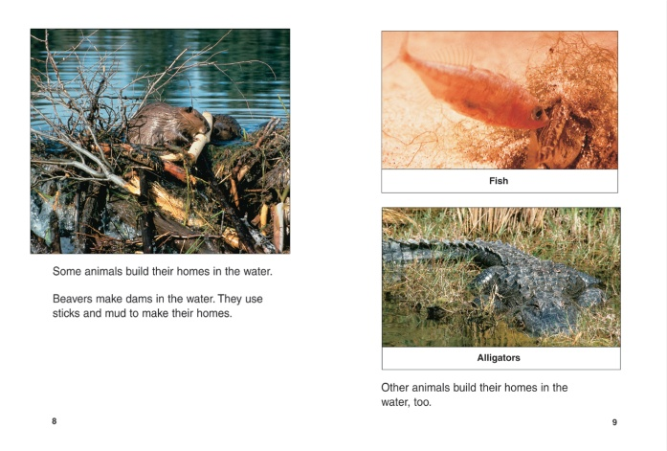



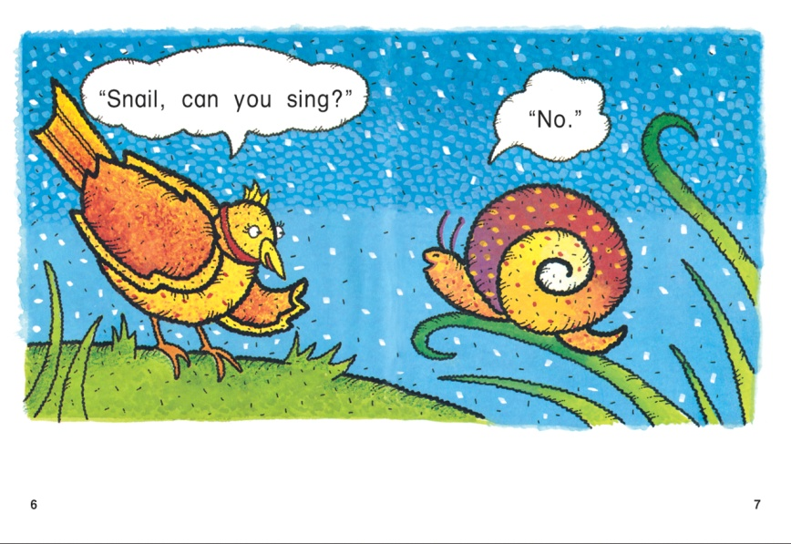
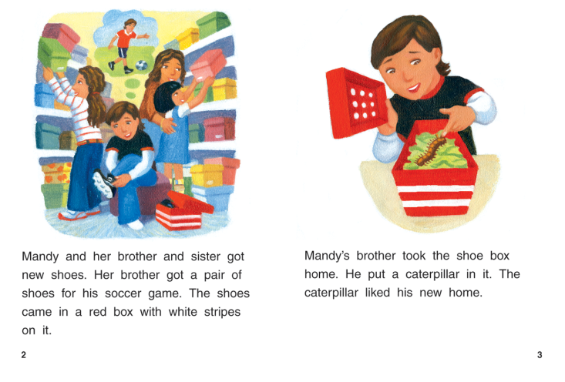
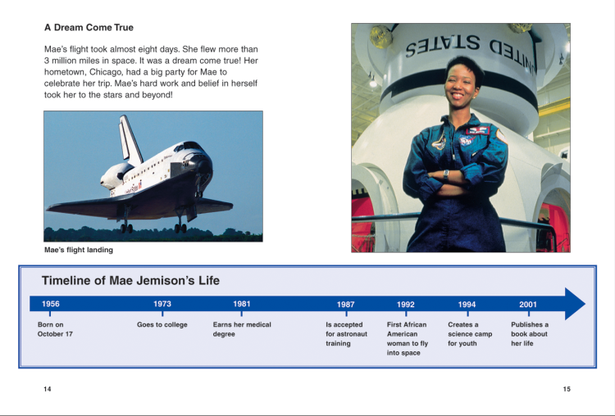
Benchmark Books

Slide 25


What is the DRA2?
Research-based with
Demonstrated Reliability and Validity
DRA2 Assesses
Reading Engagement
Oral Reading Fluency
Reading Comprehension
The DRA2 is available for grades
K-3, and 4-8.

Slide 26
The Rationale:
What are the Benefits of the DRA-2?
Developmentally appropriate assessment that’s accurate/ effective
Observe and Assess Student’s Reading Achievement
  Assessment of accuracy, fluency, comprehension, and word analysis skills
Analyze Data (compare to benchmark)
  Provides systematic documentation of student progress.
Informs:
    Informs parents of students progress
    Informs students of their independent reading level
    Informs teachers about the “instructional level” for each student, and allows teachers to flexibly group students according to their instructional levels and learning needs (Informs Effective Reading Instruction)
    Informs System about student achievement, in comparison to the benchmark, across the three campuses
Manage Assessment Information with Technology
Part of the Morrison’s balanced literacy approach

Slide 27
The Training and Timeline for the DRA-2
Step 1: Utilize 2 Team Meetings in the month of May to go over the tutorials provided online.
Step 2: Utilize the Training DVD - possibly during August PL and Team Meetings
Step 3: Begin to practice on a few students, perhaps between 2-5 students by October PL
Step 4: Meet as a group to share experiences and ask questions – October PL, Team Meetings
Step 5: Have a goal of assessing each student’s reading level near the end of the school year (April – May, 2012) [beginning in the 2012-2013 school year, the goal will be to assess each student with the DRA at least twice a year (beginning of year and end of year).]

Slide 28
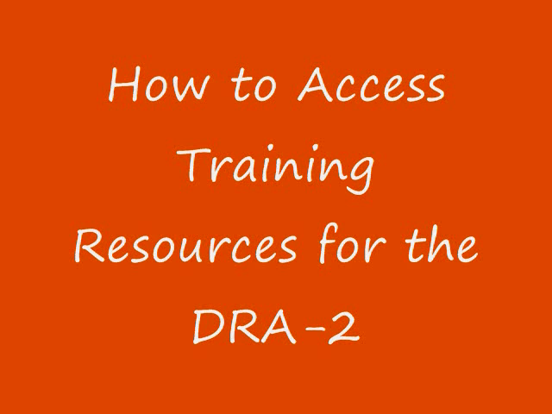

Slide 29
Final Notes…
For Grade 4-5 teachers: Correction to Training DVD for grades 4-8: This is now one file, not two, and it takes approximately 2 hours 20 minutes, not 1 ½ hours.
For K-3 teachers: Your kit will include a second assessment component, titled “Word Analysis.” This assessment has a separate Training DVD, and it is not part of Morrison’s plan to include this component during 2011-2012.
For everyone: There is no expectation for teachers to view the webinars, Training DVD, or PowerPoint slide shows even though they are accessible to you.
This presentation will be also be available to you in the same folder.
Point of Contact: Lynne Taylor

